Slide 1

DE PROJECT
Password Security Alert System
Utkarsh 2K19/IT/136
Vikas Bhandari 2K19/IT/142

Slide 2
Components of Project
The project is basically a password based security system which is implemented using logic gates and other digital electronics components.
The project can be divided into 2 components which are as follows:
Decimal to Binary Convertor
Digit comparator

Slide 3
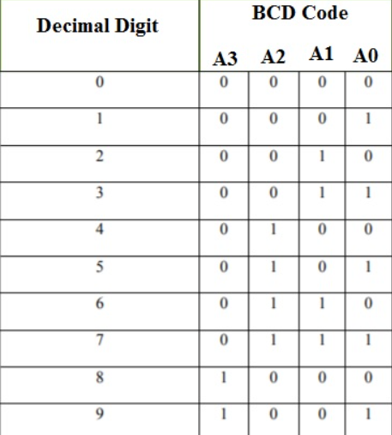
Explanation of the decimal(1 digit) to binary convertor:
To convert a decimal number into binary we have used a Decimal to BCD Encoder.
In the BCD system, the decimal number is represented as the four-digit binary.
It can convert the decimal numbers from 0 to 9 into the binary stream.
The truth table of Decimal to BCD encoder is given below.

Slide 4
Explanation of the bit comparator circuit:
The idea of this system is that the 4 switches “Key Code Switches” acts as holding the correct password for unlocking the lock.
On the other hand, the other 4 switches “Data Entry Switches” acts as data entry points where the code is to be entered to open the lock.
The “Key Code Switches” have static value and is hidden from the person who is trying to open the lock.
If the person who is trying to open the lock enters the code at “Data Entry Switches” which is similar to the code kept static at the “Key Code Switches” then the green LED will light up and the lock will open.
If he enters the wrong code then the red LED will lit up and BUZZER will start ringing, which will be the alarming situation that some wrong person is unlocking the lock.

Slide 5
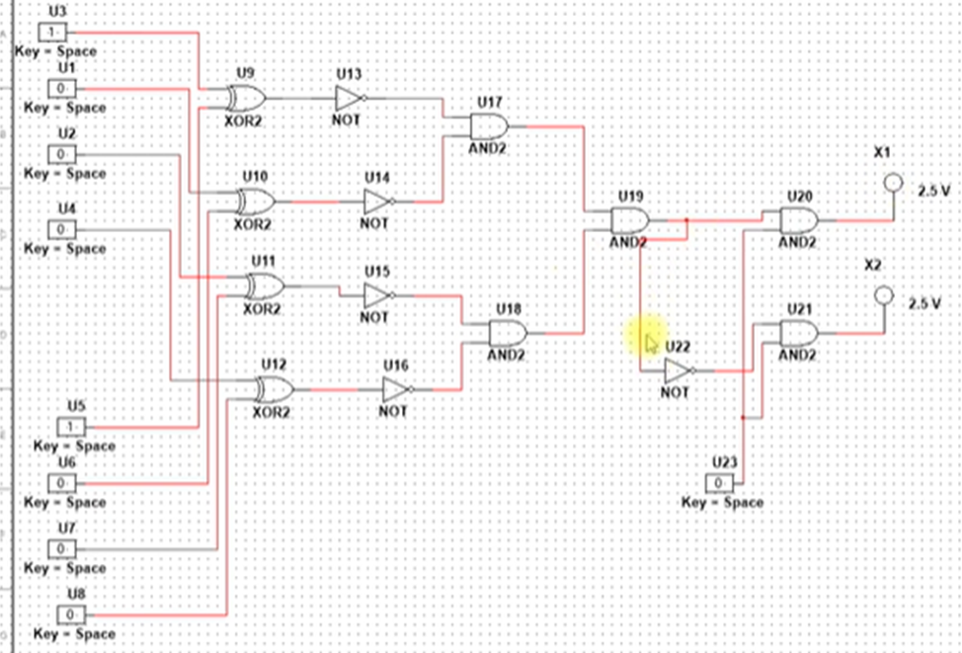
Example circuit for 4 bit security system

Slide 6
We are basically comparing every 4 bits of each decimal number one by one and checking it using the 4 bit comparator. Every decimal is converted into 4 binary bits and then checked with the already stored password. Then all the 4 output from the comparators act as input to AND Gates which is further connected to 2 different led’s via a switch.

Slide 7
Materials Required for the Password checking circuit
1) XOR Gate
2) NOT Gate
3) AND Gate
4) OR Gate
5) 6-bit Switches
6) Battery
7) Green LED (correct password)
8) Red LED (incorrect password)
9) Buzzer
10) Connecting Wires

Slide 8
Real Life Applications
1) Protection of equipment example: bags
2) Locker Security
3) Room security

Slide 9
Working
Install the IC’s and Resistors neatly on the bread board. Wire the Pins 7 and 14 of all IC’s to VCC and GND Respectively. Wire one end of the switches with VCC. Wire one end of resistors to GND. Now connect the other end of the switches to the resistors and wire it to the gates of XOR IC. Now the output of the XOR is sent as inputs in NOT IC and is grounded with help of a resistor simultaneously. Now the output of the NOT is sent as inputs in AND IC. Now the single output of the AND gate is Direct Connect to Green LED and Ground the LED with 470-ohm Resistor. Another Hand the single output of the AND gate is Connect NOT gate. Now the Output of NOT gate is Connect to Red LED and Ground the LED with 470-ohm Resistor.

